Slide 1


0
Smart Factory
MEMBERS
Precision Production Excellence
Rohit Sharma
Rohit Sharma
Rohit Sharma
Rohit Sharma
Rohit Sharma
Rohit Sharma
Rohit Sharma

Slide 2
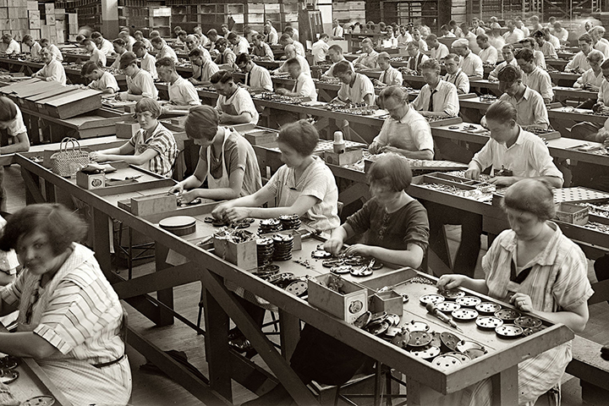

1
Manufacturing's Tech Evolution
“ In the 1950s ”
Fluctuating pay rates.
Intense labour process.
Declining interest of employees.
Workforce with little to no education.
(Before Smart Industries and Factories…)
Industries Then

Slide 3
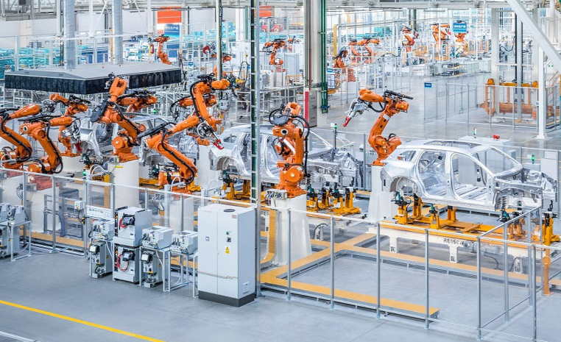
2
Manufacturing's Tech Evolution
“ Current era…”
Introduction to 3D printing
Interconnection of machines.
Overall employee satisfaction.
Automation replaced manual labour.
Increase in productivity and efficiency.
Industries Now

Slide 4
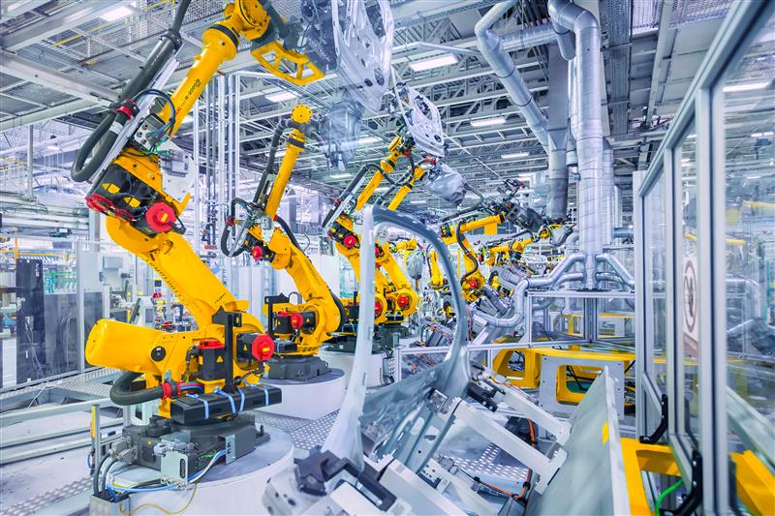
3
Introduction To Smart Factory
An interconnected network of machines, communication mechanisms, and computing power, the smart factory is a cyber-physical system that uses advanced technologies such as artificial intelligence and machine learning to analyze data, drive automated processes, and learn as it goes.
It is a digitized production facility capable of collecting and sharing data through the use of connected systems.
In the past few years, it’s become increasingly apparent to business leaders that digital transformation is an urgent priority for supply chains and manufacturing operations that hope to be competitive and resilient in the 2020s.
Smart Factory

Slide 5
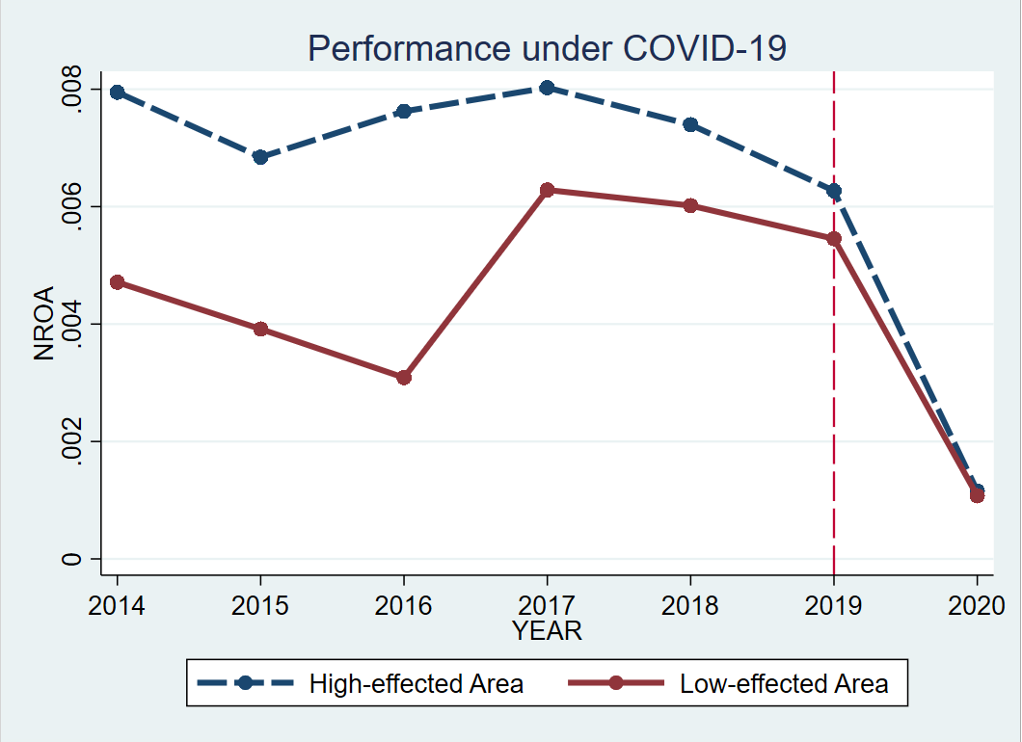
4
“ COVID-19 has shown the world something that the manufacturing industry should already know. ”
“ Traditional supply chains and manufacturing ecosystems are failing and we need to shift to an agile solution that is fully digitally enabled.”

Slide 6
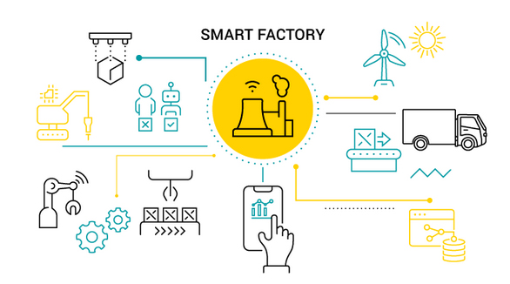
5
Technologies In Smart Factories
Principle behind the factory of the future are connectivity alongside data analysis and diagnostics; leading to less shutdowns, improved processes and optimized facilities.
It is based around using the latest technologies and connectivity to drive improvements to processes.
What differs in between normal industries and smart industry is use of variety of different technologies related to the fourth industrial revolution (Industry 4.0) to optimize smart manufacturing processes.

Slide 7
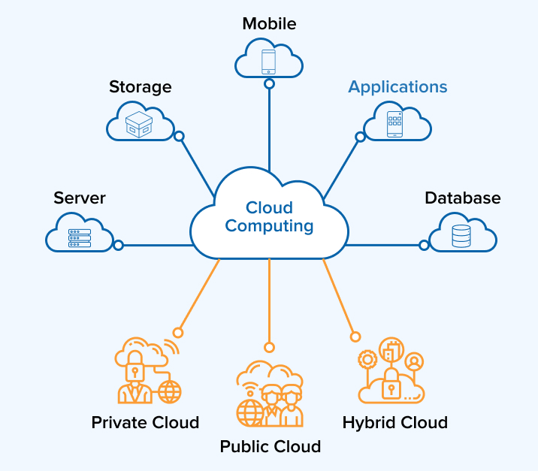
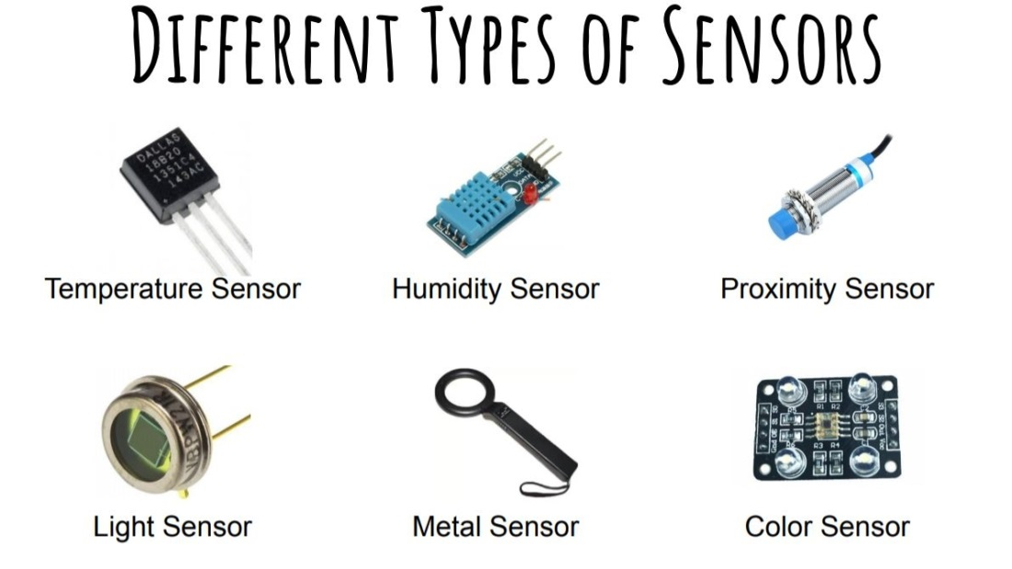
6
Technologies Include:
Sensors
Monitor temperature or other variables and either self-correct any problems or alert staff. These sensors can be linked to a network to provide joined-up monitoring across several machines.
Cloud Computing
Storing and processing data collected from the sensors is achieved through cloud computing. This if more flexible and cheaper than traditional on-site storage, allowing large amounts of data to be uploaded, stored, and assessed to provide feedback for decision-making in real time.

Slide 8

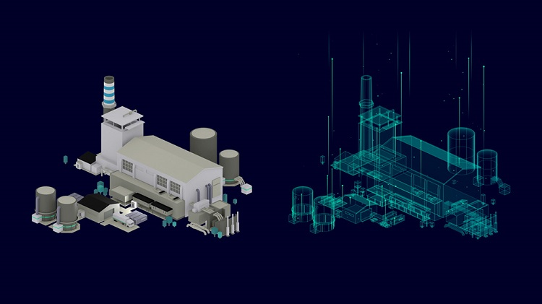
7
Virtual Reality
Digital Twin
A digital twin can be used to represent a process or physical object and simulate performance in the real world.
Virtual and Augmented Reality
Involves digital information being overlayed across reality and viewed via a smartphone, while virtual reality is a more immersive virtual world that requires special glasses.
Digital Twin

Slide 9
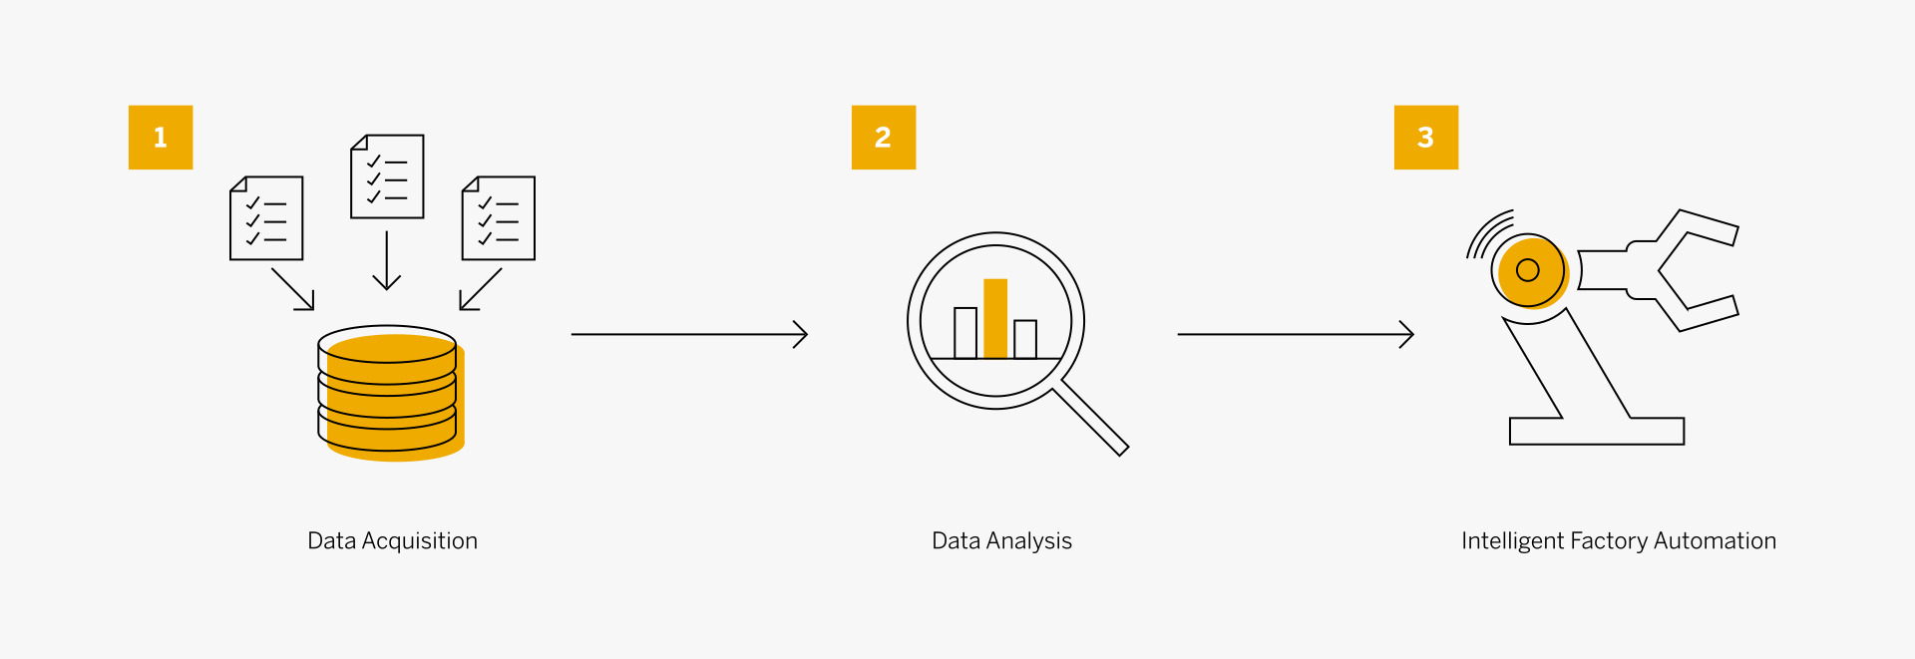

8
Structure Of Smart Factory
Data acquisition
By way of sensors and gateways, the Industrial Internet of Things allows connected machines to gather data into the system. Through myriad other data portals, AI-powered systems can compile data sets related to performance, market trends, logistics, or any other potentially relevant source.
Data analysis
Machine learning and intelligent business systems use advanced analytics and modern data management solutions to make sense of all the disparate data gathered.
Intelligent factory automation
Once the data acquisition and analysis have taken place, workflows are established and instructions are sent to the machines and devices within the system.

Slide 10

9
Benefits Of Such Concepts
According to Forbes magazine, in 2017 just 43% of manufacturers had smart factory initiatives underway. By 2019, 68% of them did. For companies that invest in digital transformation and smart factory solutions, there is potential for significant business benefits, including:
Productivity and efficiency
The use of predictive analytics and Big Data analysis allows for optimized processes to be identified and put in place. Just-in-time inventory management, accurate demand forecasting, and improved speed to market are a few of the efficiency benefits that smart factories deliver.
Sustainability and safety
Modern smart factory technologies make it easier than ever for businesses to identify and implement opportunities for more green, safe, and socially responsible manufacturing practices.
Product quality and customer experience:
In the smart factory, cloud connectivity and end-to-end visibility in smart factories brings real-time insights and recommendations to all tiers of the manufacturing process.

Slide 11
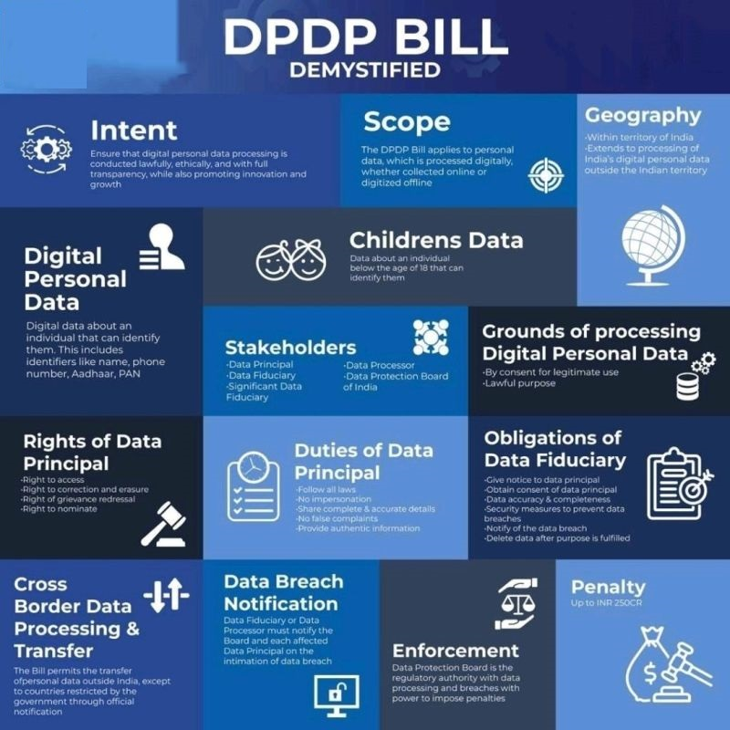

10
Steps to Initiate Smart Factories
Define Clear Objectives
Clearly outline the goals and purpose of your smart factory. Identify key performance indicators (KPIs) and set measurable targets for increased efficiency, productivity, and quality.
Conduct Comprehensive Risk Assessment
Evaluate potential risks to data security and operational continuity. Prioritize cybersecurity threats and assess vulnerabilities to develop a robust risk mitigation plan.
Implement Data Protection Measures
Adopt encryption, access controls, and secure data storage solutions to safeguard sensitive information.
Deploy Robust Cybersecurity Protocols
Integrate advanced cybersecurity measures, including firewalls, intrusion detection systems, and regular security audits.

Slide 12


11
Ensure Interoperability and Connectivity
Select compatible and standardized technologies to facilitate seamless communication between devices and systems. Prioritize interoperability to maximize the efficiency of your smart factory’s operations.
Invest in Employee Training
Train employees on cybersecurity best practices and the proper use of smart factory technologies. Foster a culture of cybersecurity awareness to mitigate the risk of human error.
Monitor and Evaluate Performance
Implement real-time monitoring systems to track the performance of your smart factory. Regularly evaluate the effectiveness of cybersecurity measures and make adjustments based on emerging threats and technological advancements.

Slide 13
12
Any Queries?

Slide 14

13

